Slide 1
CFD simulation in a patient-specific intracranial aneurysm model
Abhishek Joel George
250900

Slide 2
Scope
Hemodynamic analysis of vascular systems to understand and diagnose medical conditions.
CFD simulations to investigate the flow structure, recirculation flow and wall shear stress (WSS).
Predict the rupture of the aneurysm.
Compare the flow behavior and wall shear stress for flow velocities of 0.4 m/s and 0.8 m/s.

Slide 3
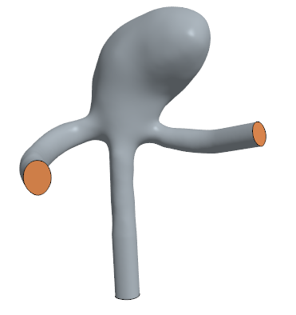
Geometry
Approx length of the geometry | 20mm
Approx length of the aneurysm | 10mm
Approx dia of inlet | 2mm
Approx dia of outlet 1 | 1.5mm
Approx dia of outlet 2 | 1.5 mm
Surface wrap base size | 0.5mm
Table 1: Dimensions
Fig. 1: Geometry

Slide 4
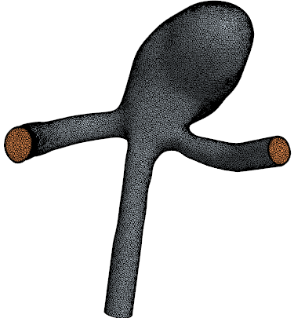
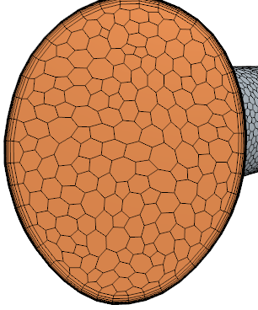
Mesh
Core Volume Mesher | Polyhedral Mesher
Surface mesher | Surface remesher
Boundary layer mesher | Prism layer mesher
Table 2: Unstructured Mesh details
Boundary | Type
Inlet | Velocity inlet
Outlet | Pressure outlet
Wall | No - slip
Table 3: Boundary conditions
Fig. 2: Mesh

Slide 5
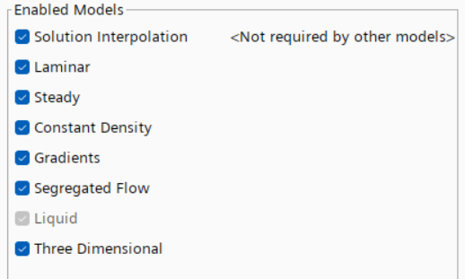
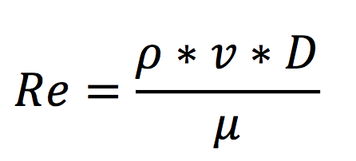
Models
Density of blood (⍴) | 1067 kg/m³
Dynamic viscosity of blood (μ) | 0.0035 Pa.s
Table 4: Properties of blood
Reynold’s number (Re):
Fig 3: Models
Velocity (v) (m/s) | Reynold’s number (Re)
0.4 | 244
0.8 | 488
Blood is modelled as a Newtonian fluid.
Reynold’s number is calculated at inlet for initial hypothesis of the flow regime
Table 5: Reynolds number at inlet

Slide 6
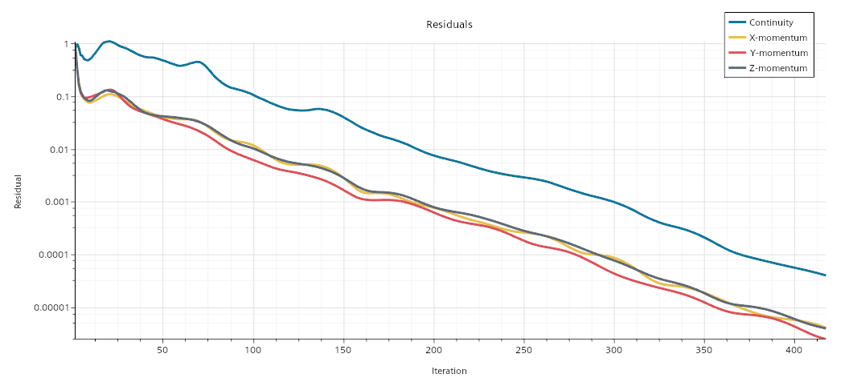
Computational Results
Stopping criteria: Residuals of continuity equation tends to 4E-5
Fig 4: Residuals for 0.4 m/s

Slide 7
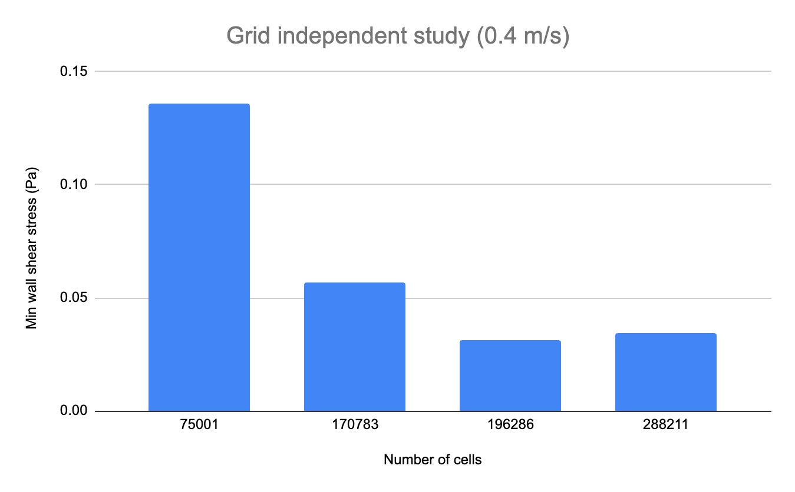
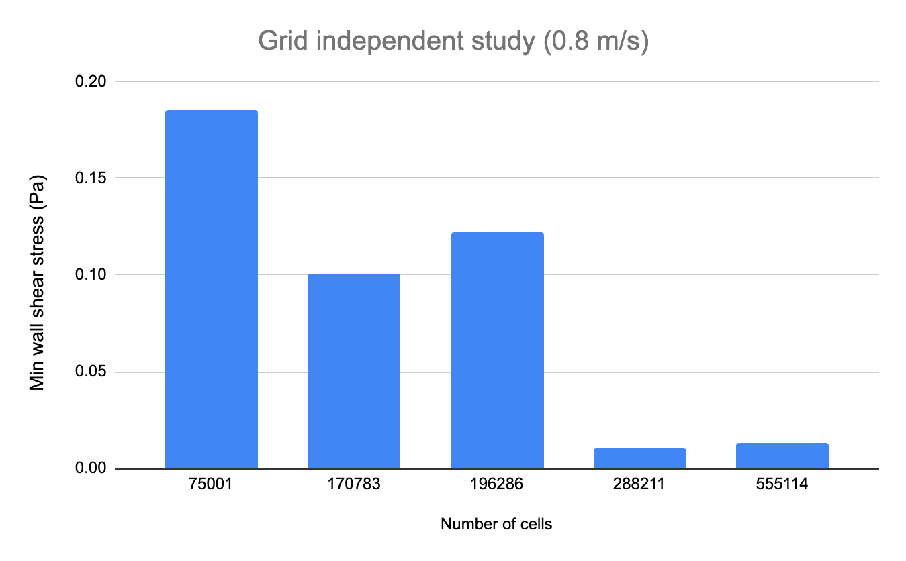
Grid independent study
Mesh parameters | Configuration for 0.4 m/s | Configuration for 0.8 m/s
Base size (m) | 0.0009 | 0.0007
Number of prism layers | 10 | 10
Volume Growth Rate | 1.2 | 1.2
Number of cells | 196286 | 288211
Fig 5: Wall shear stress vs number of cells
Table 6: Mesh
Fig 6 : Wall shear stress vs number of cells

Slide 8
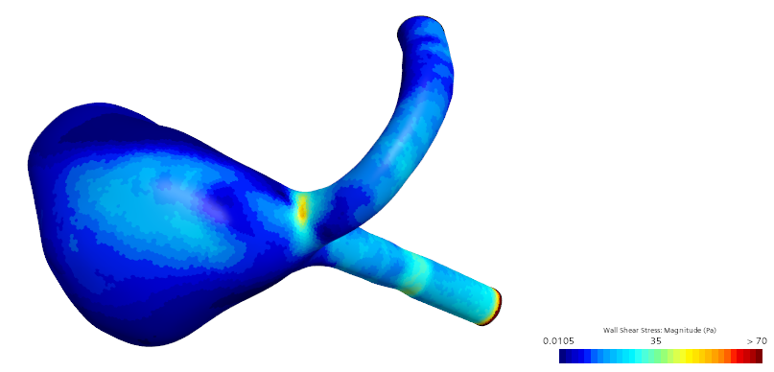
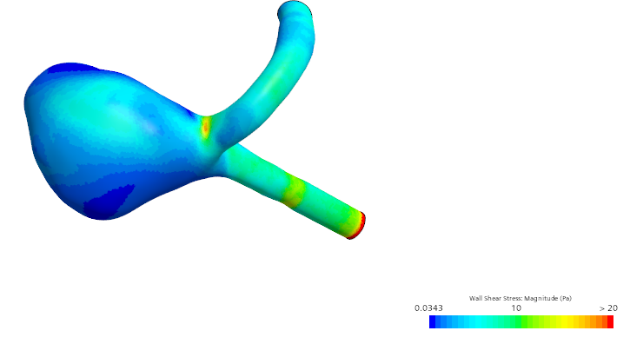
Computational results - Wall shear stress
Fig 7: Wall shear stress for 0.4 m/s
Fig 8: Wall shear stress for 0.8 m/s

Slide 9
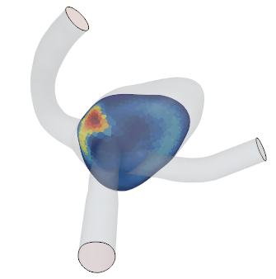
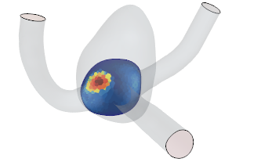
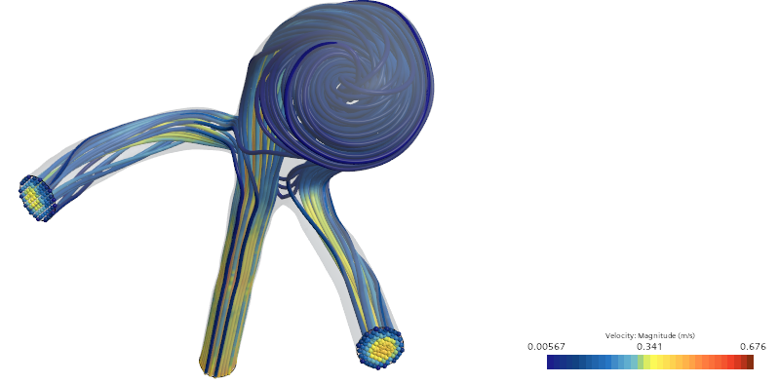
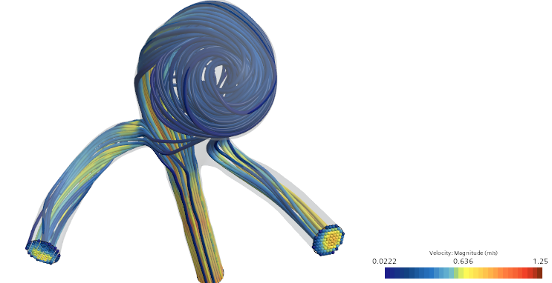
Computational results - Streamlines
Fig 9: Streamlines for 0.4 m/s
Fig 10: Streamlines for 0.8 m/s

Slide 10
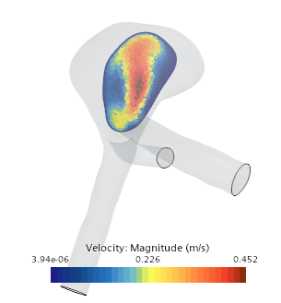
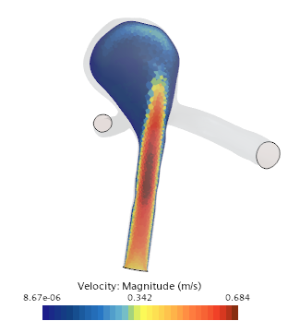
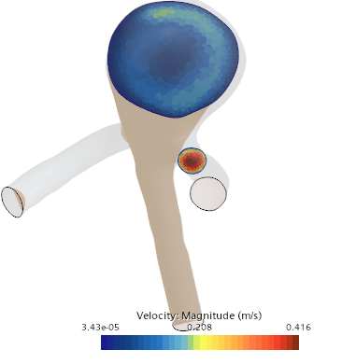
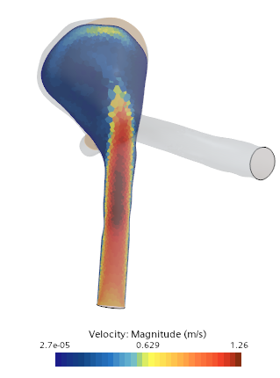
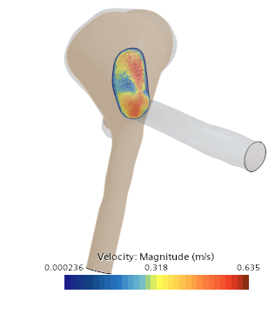
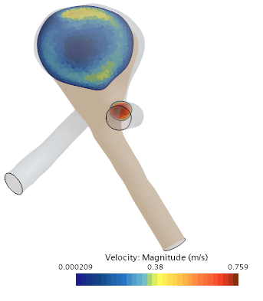
Computational results - 2d velocity profiles (vertical)
Fig 11: velocity profile - 0.4 m/s
Fig 12: velocity profile - 0.8 m/s

Slide 11
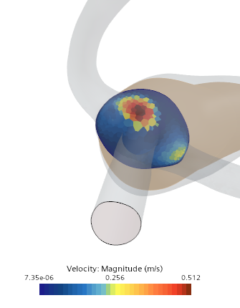
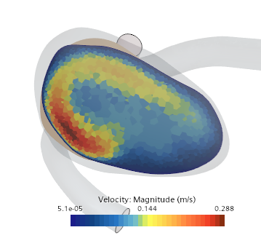
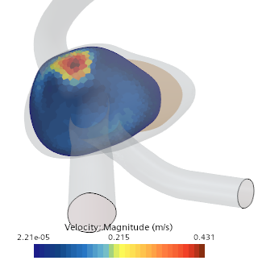
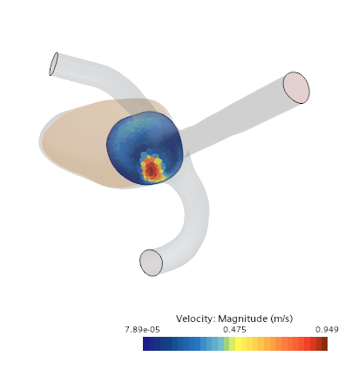
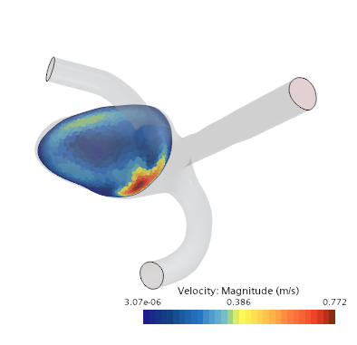
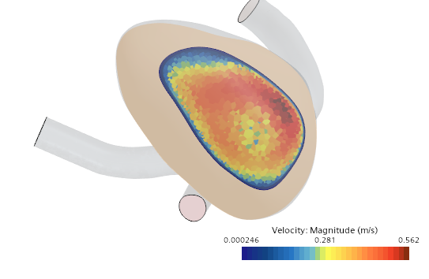
Computational results - 2d velocity profiles (horizontal)
Fig 13: velocity profiles for 0.4 m/s
Fig 14: velocity profiles for 0.8 m/s

Slide 12
Summary
Velocity (m/s) | Min wall shear stress (Pa) | Max wall shear stress (Pa)
0.4 | 0.0343 | 10
0.8 | 0.0105 | 25
Table 7: Summary
Results are in close agreement with literature.
The geometry induces vorticity inside the bulge of the aneurysm.
Sharp variation in wall shear stress may cause rupture.
The configuration for flow velocity of 0.8 m/sec is more prone to rupture.

Slide 13
Future scope
Investigate rupture of aneurysm by modelling a flexible wall.
Try modelling blood as a non-Newtonian fluid.
Modelling using turbulence for higher velocities
Provide velocity distribution at inlet rather than uniform distribution.

Slide 14
References
Rahma, Ahmed. (2023). Hemodynamic and fluid flow analysis of a cerebral aneurysm: a CFD simulation. SN Applied Sciences. 5. 62. 10.1007/s42452-023-05276-0.
Paritala, Phani & Anbananthan, Haveena & Hautaniemi, Jacob & Smith, Macauley & George, Antony & Allenby, Mark & Benitez, Jessica & Wang, Jiaqiu & Maclachlan, Liam & Liang, EeShern & Prior, Marita & Yarlagadda, Prasad & Winter, Craig & Li, Zhiyong. (2023). Reproducibility of the computational fluid dynamic analysis of a cerebral aneurysm monitored over a decade. Scientific Reports. 13. 10.1038/s41598-022-27354-w.
Wu, X., Gürzing, S., Schinkel, C., Toussaint, M., Perinajová, R., van Ooij, P., & Kenjereš, S. (2021). Hemodynamic Study of a Patient-Specific Intracranial Aneurysm: Comparative Assessment of Tomographic PIV, Stereoscopic PIV, In Vivo MRI and Computational Fluid Dynamics. Cardiovascular Engineering and Technology, 13(3), 428-442. https://doi.org/10.1007/s13239-021-00583-2

Slide 15
Thank You

